Slide 1
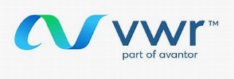
Enhancing Your Sustainability Strategy
with The RightCycle™ Program
Tonya Anderson
Kimberly-Clark Scientific Account Manager

Slide 2
Specific Targets for 2019-2030 include:
30% Reduction in Landfilled Waste
30% Reduction in Greenhouse Gas Emissions
20% Reduction in once-through freshwater use
Notes:
Looking at Hexcel’s vision for sustainability I see that our companies share the same passion and vision.

Slide 3
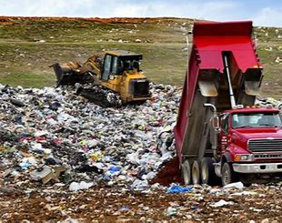
Local County Landfill where your PPE is currently going…..
Notes:
This is a local landfill in Polk county. I am a very visual person and like to share where your PPE is currently going now.

Slide 4
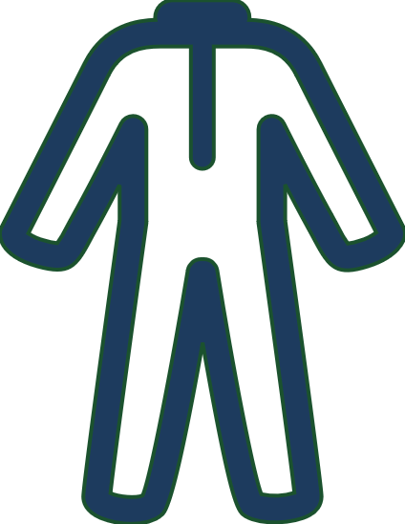
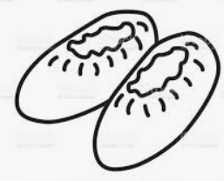
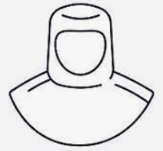
The RightCycle™ Program
The first TRUE, end-of-life recycling platform
Creates a lifecycle solution for single-use nitrile gloves, apparel, eyewear and masks
Kimberly-Clark Professional products used in non-hazardous applications accepted into the program:
Nitrile & Latex Gloves
Garments/Apparel
Hoods
Bouffant Caps
Masks
Beard Covers
Shoe & Boot Covers
Safety Eyewear
For Kimberly-Clark Non-Hazardous Used PPE

Slide 6
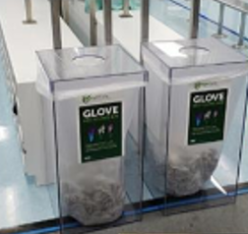
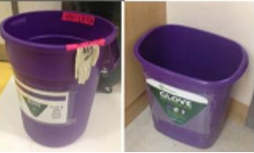
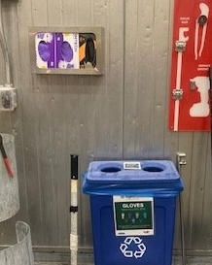
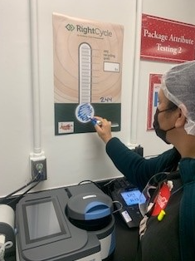
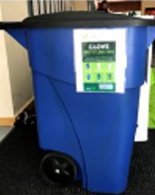
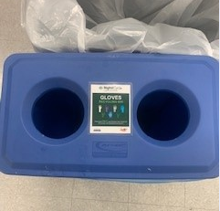
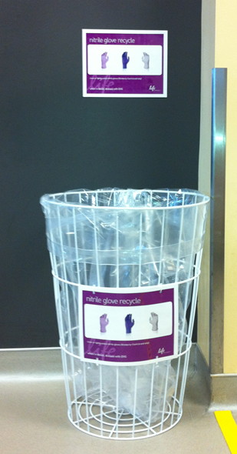
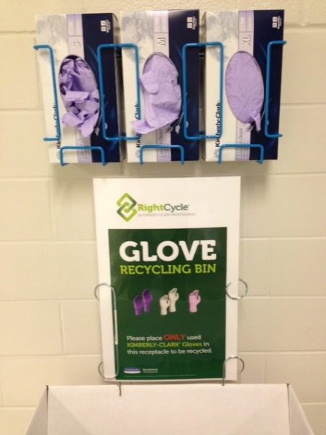
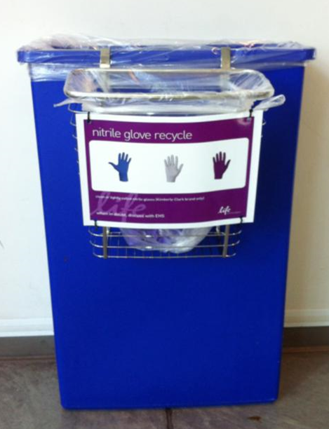
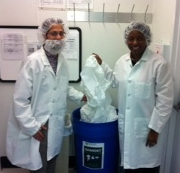
Collection used PPE items KCP Garments, Gloves, Eyewear, Masks
Bin placement and visual management are critical aspects of a successful recycling program and KCP can help with implementation.
³ Average weight of African elephant (male) of 9,000 lbs.
www.seaworld.com
Notes:
Step 2 is Collection
Once the product is used, collect it in designated bins.
For recycling purposes, we ask that nitrile gloves are collected separate from apparel and eyewear.
Collect them using containers or corrugate you already have in your facility

Slide 7
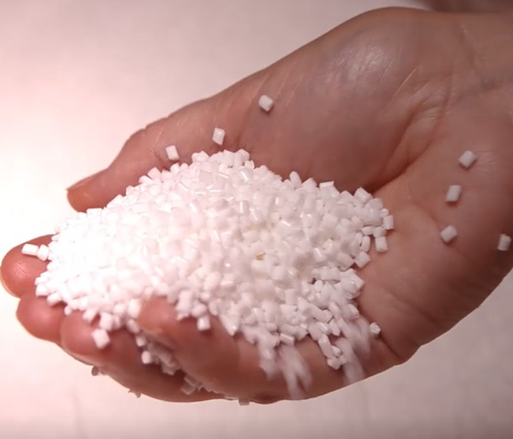
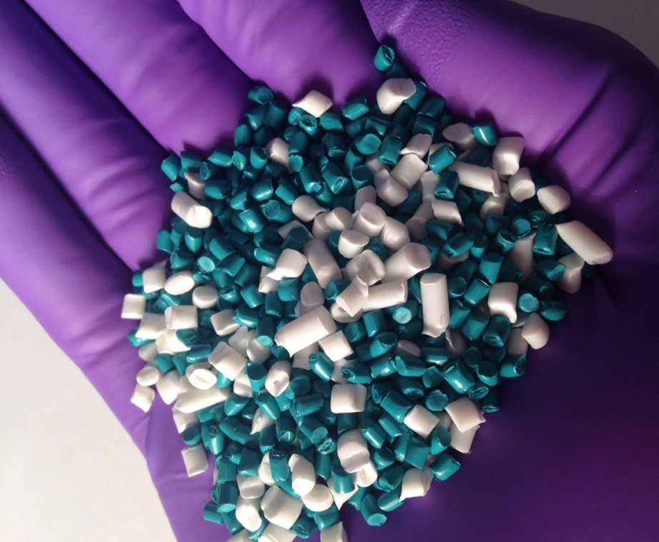
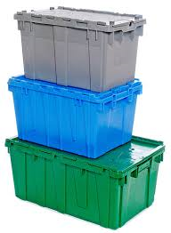
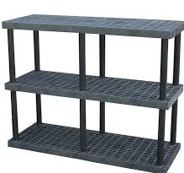
Used PPE are Converted
Somerset Recycling Services, Inc. processes all used PPE and works with various molding solutions to make new products.
PPE processed into new resin
Resins molded into new consumer goods
³ Average weight of African elephant (male) of 9,000 lbs.
www.seaworld.com
Notes:
Step 5: Conversion
Once a full load of baled, used PPE is ready, it ships to our recycling partner, Somerset Recycling Services, Inc. to be converted into new polymer resins to be sold into various molding applications to make new consumer goods!
Some of the key products that are being made with recycled PPE are:
flowerpots
Adirondack chairs
Industrial shelving and totes
The best part of the program is that all of the processing happens in the United States and the program is fully auditable!

Slide 8
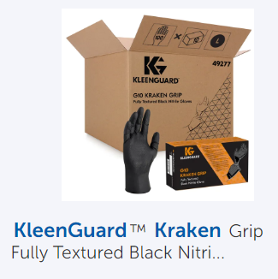
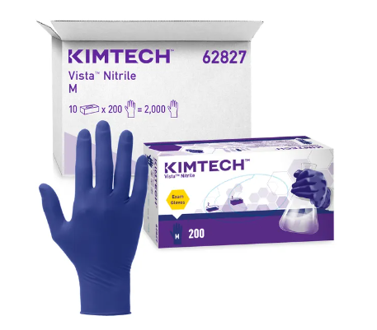
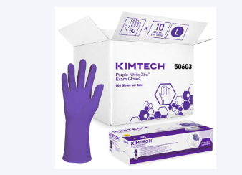
Your Potential waste diversions
500 lbs. of gloves a quarter
Converting to all Kimberly-Clark Gloves
2000 lbs. or 1 ton of waste diverted annually with RightCycle!
Notes:
Example of possible waste metrics

Slide 9
Q&A

